Slide 1

Healthcare Funding & Outcomes Analysis
Visualizing the Landscape of Healthcare Research Funding
Submitted by: Anjali Sinha | ID: CX-138-MOR-JUNE

Slide 2
Project Foundations
Transforming complex multi-variable public health financial datasets into interactive visual dashboards using Tableau.

Slide 3


Executive Summary & Scope
Context & Challenge
Methodological Approach
Public health management relies on tracking how financial capital flows across medical research domains. Analyzing decades of funding records (2008–2024) alongside mortality and disease prevalence requires robust data architecture.
Integrating historical data, federal legislative injections (ARRA), and predictive modeling to align resource allocation with national health burdens, equipping policymakers with empirical clarity.

Slide 4
Strategic Analytical Objectives
Trend Analysis: Track historical shifts in funding (2008–2024) across distinct disease categories to evaluate consistent institutional support.
Comparative Evaluation: Assess annual funding distributions and structural priorities between competing medical research domains.
Outcome Correlation: Analyze statistical relationships between research expenditures and real-world health indicators like 2019 US mortality.
Economic Impact: Evaluate how major stimulus packages (e.g., ARRA) accelerated development across target medical sectors.

Slide 5
Dashboard Insights & Metrics
Evaluating funding distributions, high-priority allocations, and distribution anomalies.

Slide 6
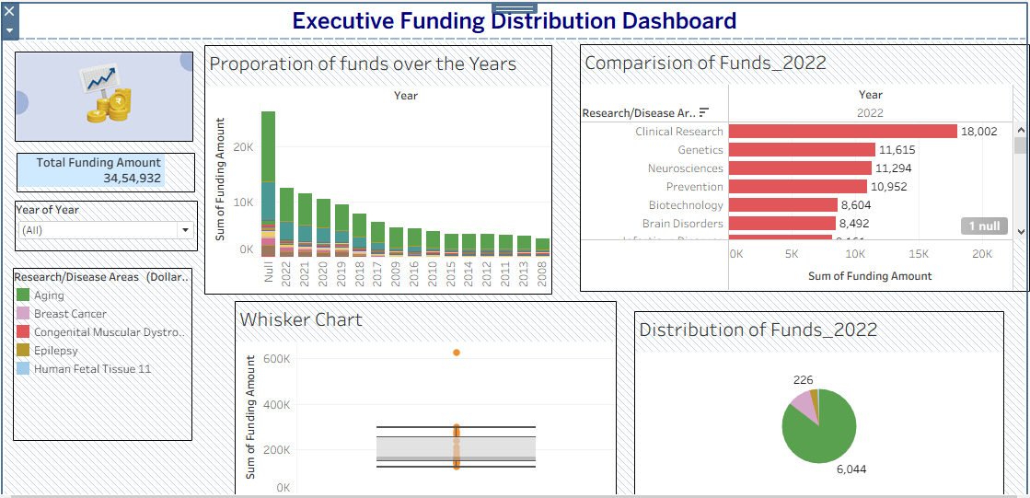
Funding Volume & Yearly Proportions
Cumulative Capital: Total recorded funding stands at 34,54,932 (Indian numbering system format).
Historical Decay: Defined yearly funding peaks strongly in recent cycles (2022 clearing 10K) and progressively decreases toward 2008.
Data Integrity Note: A prominent "Null" category spike indicates unclassified records lacking proper year-tags.

Slide 7
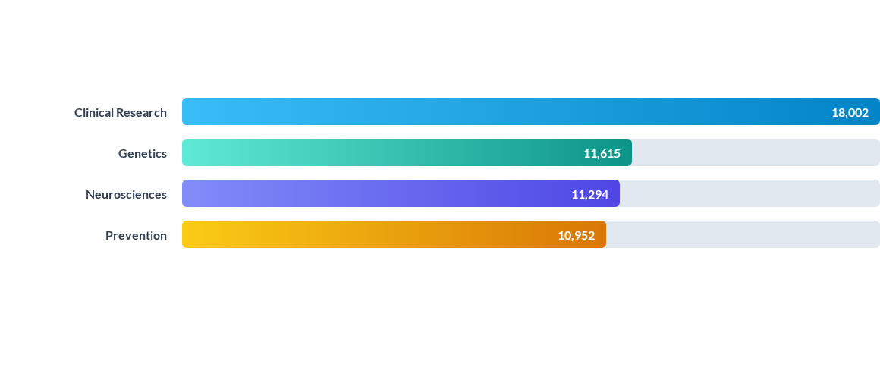
2022 Research Domain Priorities
Clinical Research commands the clear lead in 2022 resource allocation, closely backed by foundational biosciences like Genetics and Neurosciences.

Slide 8


Distribution Spread & Outlier Analysis
The Whisker Distribution
Extreme Funding Outlier
The vast majority of project funding data points cluster tightly between the 100K and 300K thresholds within the standard quartile boundaries.
A highly prominent statistical anomaly sits past 600K on the Y-axis, representing a singular mega-grant or institutional initiative far outside typical variance.

Slide 9
Disease-Specific & Intensity Analytics
Isolating high-burden medical conditions and examining multi-year financial trajectories.

Slide 10
Longitudinal Tracking: Liver Cancer
Growth Trajectory: Funding starts at 89 (2008), experiences a valley between 2011–2014 (low of 71), and enters a sustained post-2015 upward climb to peak at 178 in 2022.
Policy Correlation: Post-2015 increases reflect targeted federal attention toward hepatic disease burdens and diagnostic improvements.

Slide 11
Funding Intensity Across Disease Sectors
Research / Disease Area | Funding Intensity ($ Millions Rounded)
Aging | 66,402 (Dominant Tier)
Acquired Cognitive Impairment | 24,865
Alzheimer's Disease ( incl. AD/ADRD ) | 24,499
Alcoholism, Alcohol Use and Health | 8,891

Slide 12
Strategic Insights & Recommendations
Financial Resilience
Optimizing Future Allocations
Sustained capital commitment in sectors like Aging and Clinical Research demonstrates robust institutional resilience against macroeconomic volatility.
Bridging geographic and categorical data gaps ensures future capital models directly address true national mortality burdens and regional care disparities.

Slide 13
Questions?
Thank you for your attention. Open for discussion.
Healthcare Funding & Outcomes Analysis | Anjali Sinha

